Slide 1
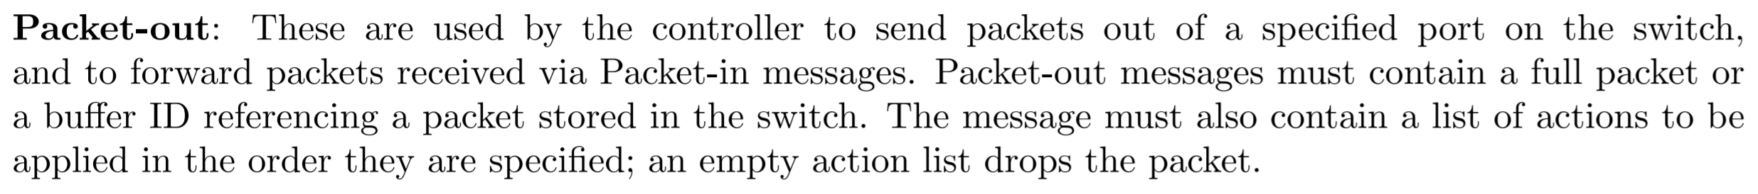
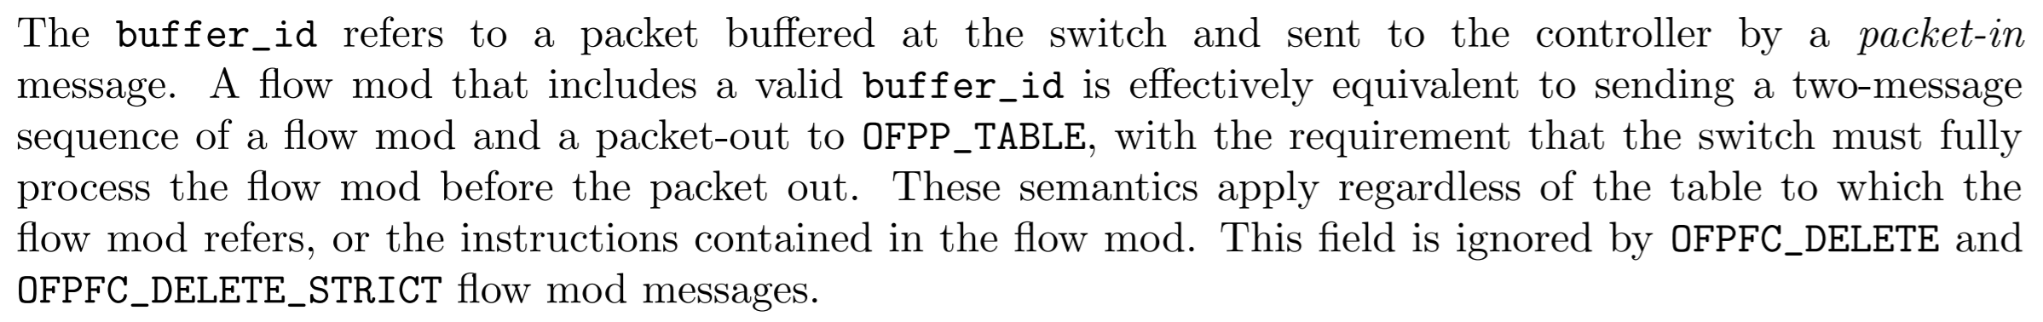
Lab 3 Recall
Packet-out defined in OpenFlow 1.3
Make sure to Packet-out when you send Flow-mod
Since flow modification message only install flow rule on the switch
… without buffer ID
Flow modification messages with buffer ID
Refer from OpenFlow specification v1.3.0

Slide 2
Project 4
Path Service
Date: | 2019/04/11 (Thu.)
Deadline: | 2019/04/28 (Sun.)

Slide 3
Ryu – What Should an SDN Application do?
Request Packet-in
switch_features_handler()
Handle Packet-in
_packet_in_handler()
Packet-out
OFPPacketOut()
Flow-mod
add_flow() // OFPFlowMod()
Refer from Ryu SimpleSwitch13

Slide 4
ONOS – What Should an SDN Application do?
Request Packet-in
requestIntercepts()
Handle Packet-in
PacketProcessor{process()}
Packet-out
packetOut() // PacketContext.setOutput().send()
Flow-mod
installRule() // FlowObjectiveService.forward()
Refer from ONOS v1.15 ReactiveForwarding

Slide 5
Outline
Project 4 Requirements
Reference

Slide 6
Outline
Project 4 Requirements
Reference

Slide 7
Project 4 Requirements
Path Service
Notes:
說明有兩種方式 CLI AND restful api

Slide 8
Requirement
Write a path service application which finds a path
Construct a graph of network topology when Packet-in
Find a path between the source and destination
You could use algorithms like BFS, Dijkstra or spanning tree
Shortest path algorithms are not required
Proactive install flow rules on each devices in the path
Each packet from hosts would only trigger one Packet-in
Flow rules would be proactively installed on devices in the following path
Compare with reactive forwarding such as SimpleSwitch13 in Ryu or ReactiveForwarding in ONOS

Slide 9
Write ONOS Application
You code should be placed under `src/main/java/nctu/winlab/testapp/`
A template code is created , and you can simply use it
$ cd <artifactId>
$ vi src/main/java/nctu/winlab/testapp/AppComponent.java

Slide 10
Compile, Install and Activate ONOS Application
Compile ONOS application
Run ONOS
Install and activate ONOS application
Note: By using an exclamation mark with `install` parameter, the application will be activated immediately after being installed
$ cd <artifactId>
$ mvn clean install -DskipTests
$ ok clean
$ onos-app localhost reinstall! target/<package>-<version>.oar

Slide 11
app deactivate fwd
tools/test/bin/onos localhost
cd $ONOS_ROOT/tools/package/archetypes/app
onos-app localhost reinstall! target/app-1.0-SNAPSHOT.oar
$ mvn clean install -DskipTests
http://localhost:8181/onos/ui

Slide 12
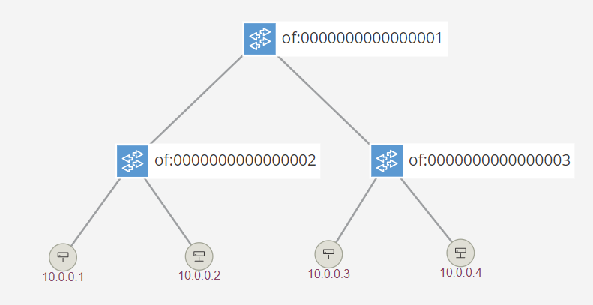
Demonstration (I)
Using Mininet tree topology with depth in 2
$ sudo mn --controller=remote --topo=tree,depth=2

Slide 13
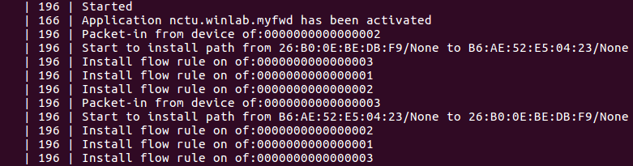
Demonstration (II)
Ping from h1 to h3
ONOS log
Only devices connected source hosts would send Packet-in
Flow rules would be installed on devices in the following path
mininet> h1 ping h3

Slide 14
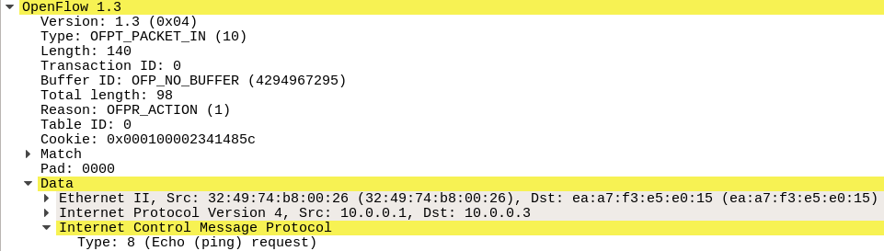
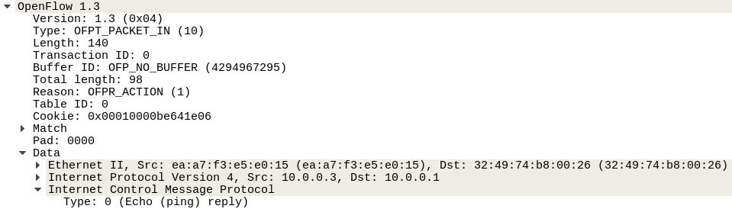
Demonstration (III)
Capture OpenFlow packets from Loopback interface
Each ICMP request and reply only trigger one Packet-in

Slide 15
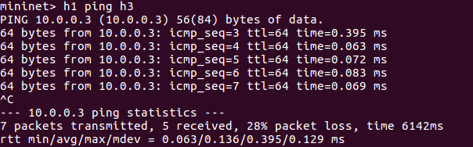
Demonstration (IV)
Forwarding packets in data plane is much faster than installing flow rules in controller plane
Pingall in Mininet only take one ICMP packet into consideration
Thus, pingall would not work
Use ping to test your program
Refer from GitHub mininet/mininet - mininet/net.py

Slide 16
Hints
Since forwarding packets in data plane is much faster than installing flow rules in controller plane
Install flow rules on network devices from destination to source in the path
Do not Packet-out when installing flow rules
Or the packet which triggers Packet-in would reach the next device before the flow rule successfully installed
The first packet is inevitably lost due to timeout
That is why always two packet loss in every ping

Slide 17
Outline
Project 4 Requirements
Reference

Slide 18
Reference
Path Service
Notes:
說明有兩種方式 CLI AND restful api

Slide 19
Reference
Ryu
Ryu API Reference
https://ryu.readthedocs.io/en/latest/api_ref.html
Ryu GitHub – ryu/ryu/topology/api.py
https://github.com/osrg/ryu/blob/master/ryu/topology/api.py
ONOS
ONOS Java API 1.15.0
http://api.onosproject.org/1.15.0/apidocs/
ONOS TopologyService.getGraph() would return the topology graph
DO NOT use ONOS built-in APIs to find paths (e.g. TopologyService.getPath())

Slide 20
Submit to e3
Files
All files of your application
Submit
Upload “.zip” file to e3
Named: project4_studentID.zip
Wrong file name or format would not be scored

Slide 21
Hints for Demo Scenario
Finding paths
Your application should be able to deal with loops in the topology
Proactive installing flow rules
Please check if only two Packet-in are captured from Wireshark instead of logging
Since controller like ONOS would abstract some operations below
Probably do not set timeout too short in case that switches trigger another Packet-in after flow rules timeout

Slide 22
Thank you
Q & A

